Slide 1
Hello EVERYONE

Slide 2
Face detection and recognition using opencv
This project process on Artificial intelligence

Slide 3
TEAM MEMBER
MD. Rashed Sarder 153402304
MD. Shafiqul Islam 153402305
Bayazid Bostami 153402319
Jahidul Islam 153402303

Slide 4
Artificial intelligence
Artificial intelligence(AI) is the intelligence of machines and the branch of computer science that aims to create it.

Slide 5
Motivation
To identify a human face from an image is the main purpose
To study Open CV and implement it in this project.
To understand how face detection method works.

Slide 6
Features
It can detect all the faces from an image.
It is easy to use.
It can work on low configured computer.
It does not use too much disk space.
Its requirement is easy to get and all software is free in online.

Slide 7
Uses of Face Recognition System
Fraud Detection for Passports and Visas
ATM and Banks
Identification of Criminals
Prevent Fraud Voters
Track Attendance

Slide 8
Components
Hardware Components:
A computer
Processor minimum Intel core i5
4GB ram
Hard disk storage 1TB
Software Components:
Operating system : Windows 10
Python 3.7.1
Numpy
Matplotlib
OpenCV 3.0

Slide 9
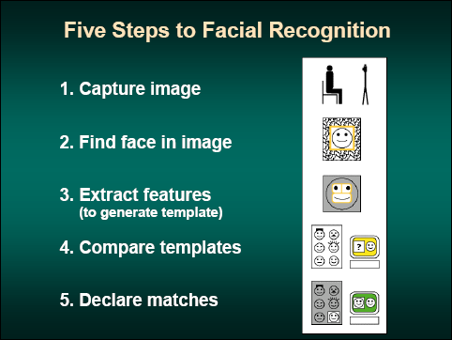
General phases in Face Recognition

Slide 10
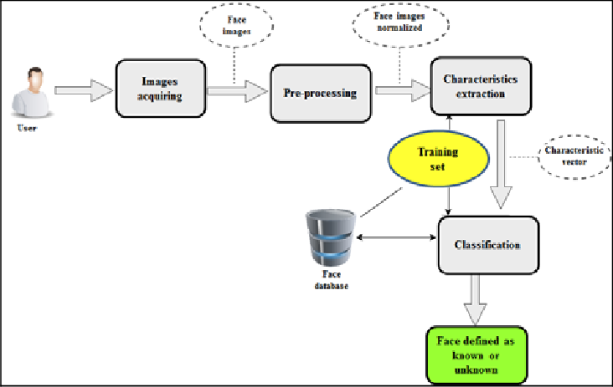
Flow chart diagram

Slide 11
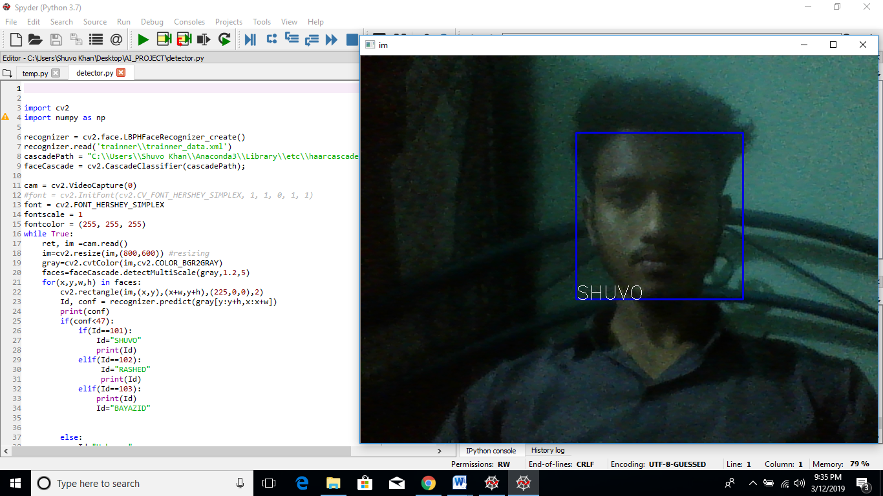
IMPLEMENTATION IMAGE:

Slide 12
Thank You

